Slide 1
Visual Perception of Self Driving Cars
Sanket Godbole BE16F04F006
Hrishikesh Janjal BE16F04F015
Devendra Pawar BE16F06F043
Sourav Kanade BE16F06F023

Slide 2
Project Review
Our Project Consist of 3 Parts :
Lane-Line Detection
Traffic Sign Recognition
Developing Autonomous Vehicle Using Simulator

Slide 3
Lane Line Detection
In this Part We are going to identify lanes of Road.
This part Mostly Consist of OpenCV and NumPy Libraries for the image processing.
Data Used : Image and Video Stream.

Slide 4
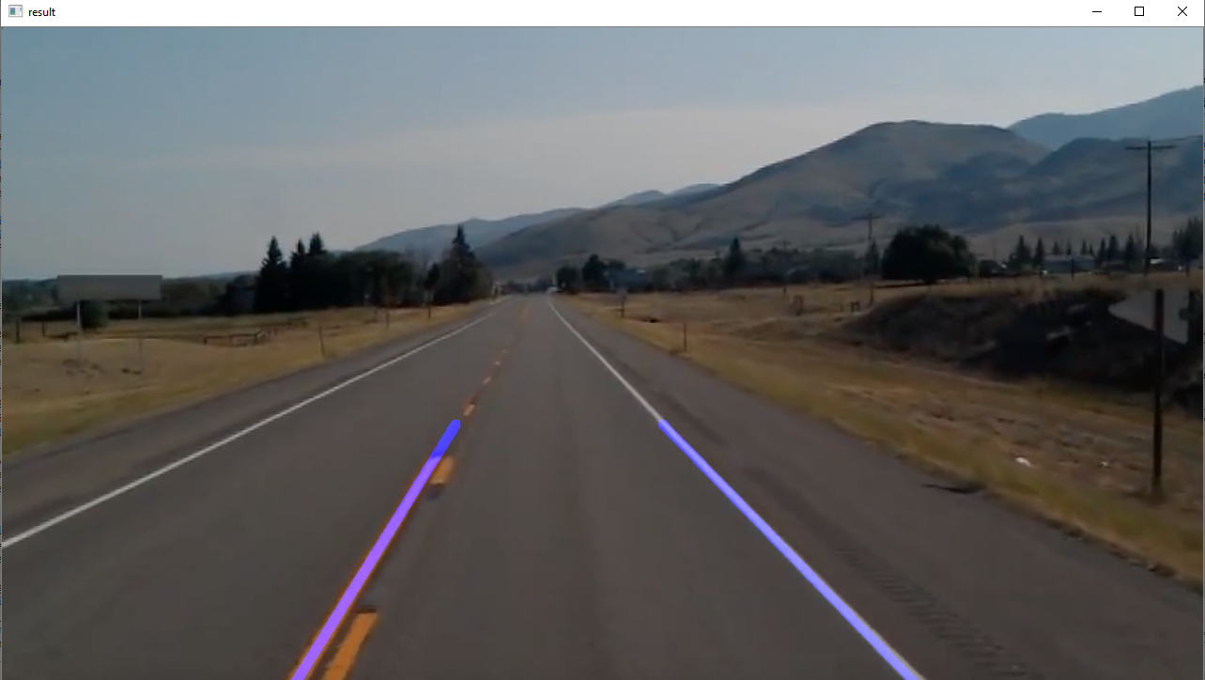
Lane Line Result

Slide 5
Traffic Sign Recognition
In this Part We are using Keras Library.
keras is neural network library which is written in python.(simply API of Neural network)
it has capability to run on top of the tensorflow,CNTK and theano.(They are backend engines required for Keras)
Data set used : traffic-signs contains 210 images
Reference : https://bitbucket.org/jadslim/german-traffic-signs

Slide 6
Keras Models used
Conv2D - it is a convolution layer which creates a convolution kernel that is wind with the input layer which produces tensors of output.
Maxpooling2D - It is discretization process usually used for the down sampling.
pickle library is used for serializing the model and save it.

Slide 7
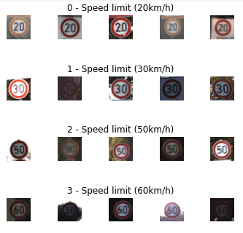
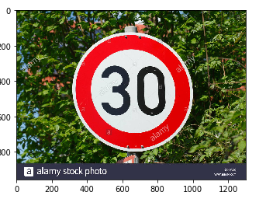
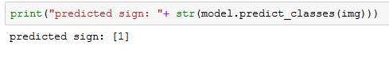
Traffic Sign Recognition

Slide 8
Self Driving Car Simulator
We will train the Car in simulator and then test car using our Cloning.
Here we will collect Data by driving the car in simulator.
Preprocess the Images
Train these Images
Pass these images in our cloning model and Our Car will able to Drive with help of our Cod.

Slide 9
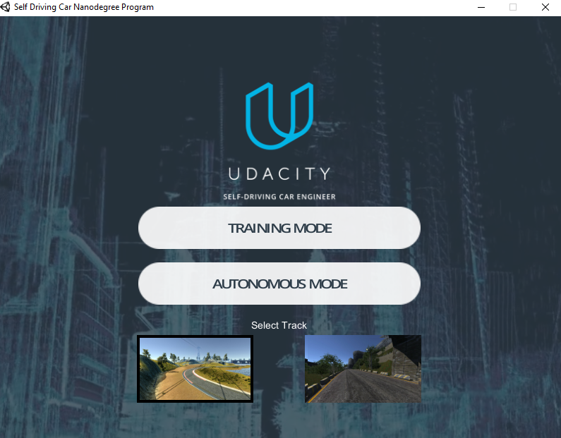
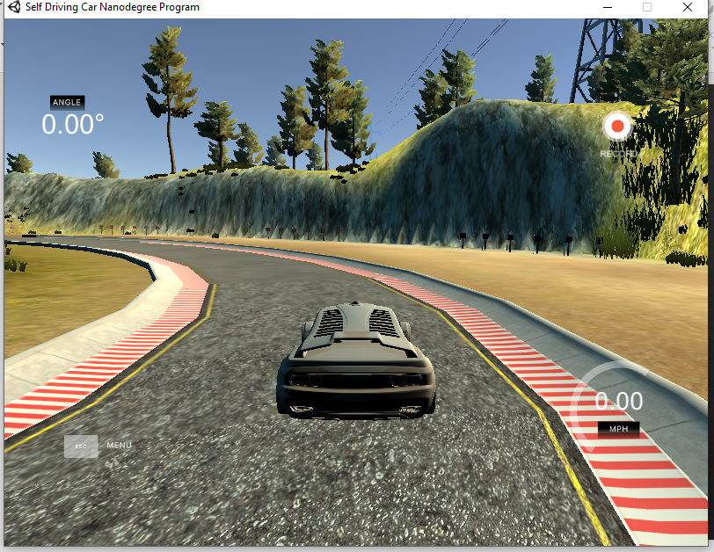
Data Collection

Slide 10
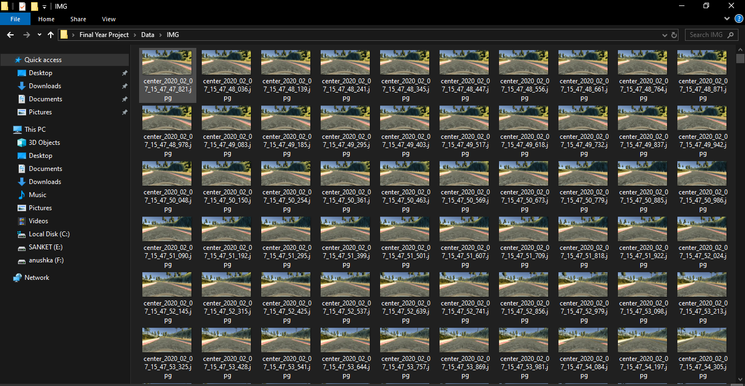
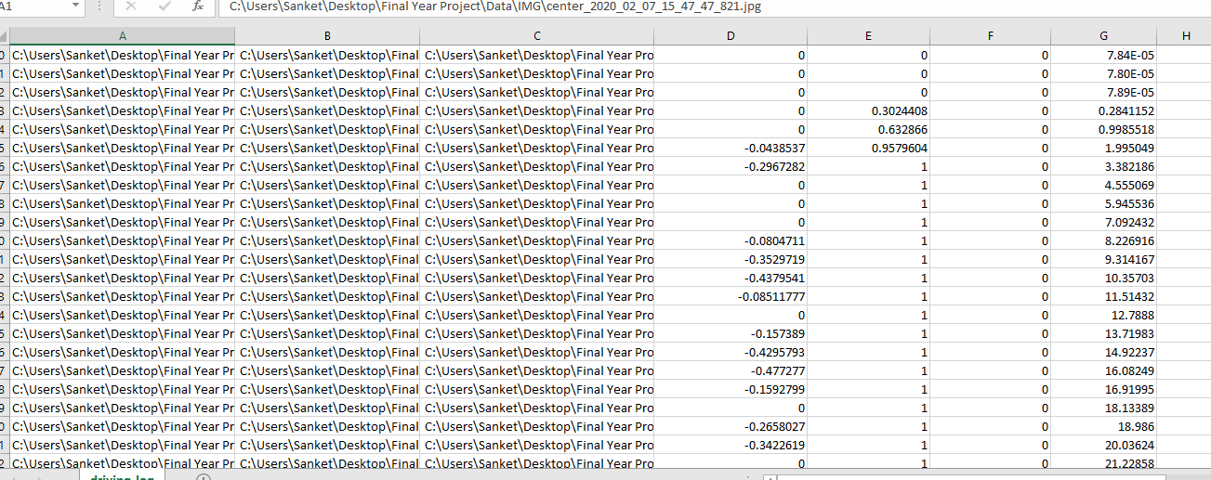
Data Gathered

Slide 11
Behavioral Cloning
For the Behavioral cloning process We feed the data that we gathered to the Model.
Here we used Model which is proposed by NVIDIA.
We Created the Environment that has all the necessary Library Requirements and activated it.(Tensorflow, Keras, etc).

Slide 12
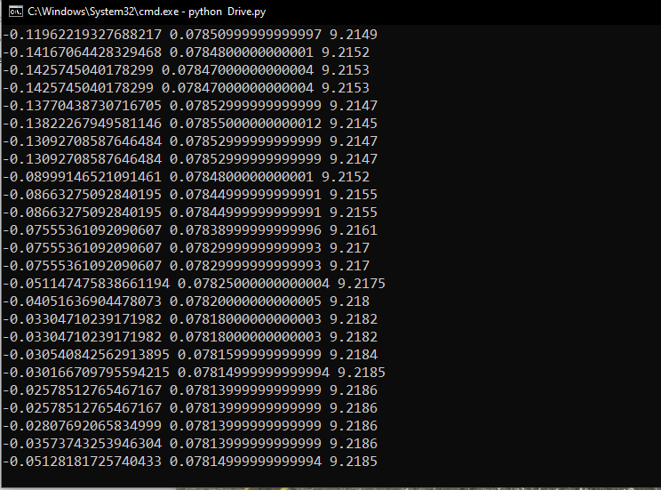
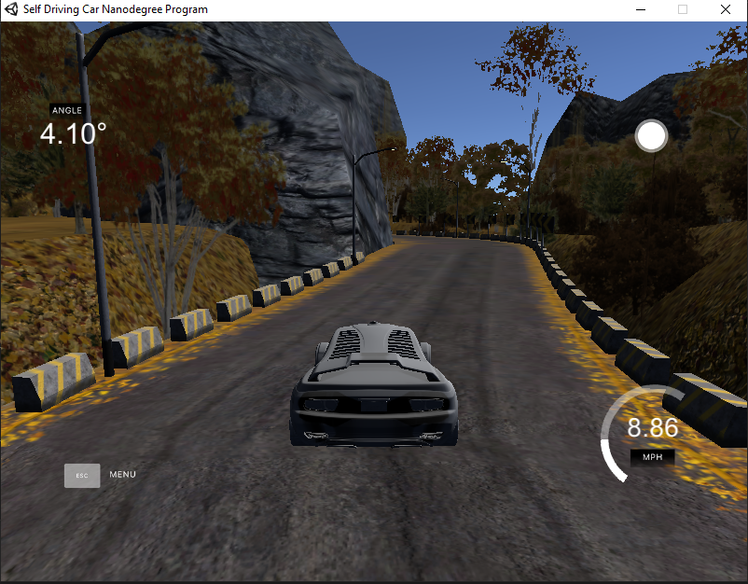
Results

Slide 13
THANK YOU

